Slide 1
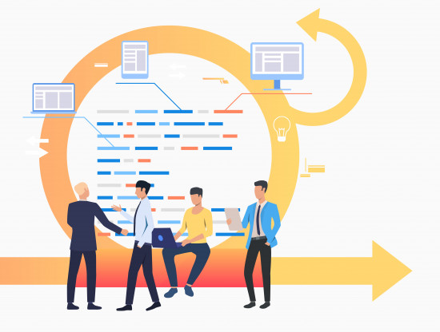
Agile
Session 1
Notes:
Hi everybody,
Welcome to Agile class. Hope everything is well for you.
Today we are here in Agile class.
I am waiting for all of you to join peardeck.
While waiting lets talk about todays class.
Agile is a 2-session class. We will learn a mindset here, maybe the ethic of modern project management. After that, we will learn how to use Jira with Agile approach. It will be also 2-session class.
after that the first part of this course will finish. Happy for you :)
Today we will learn what Agile is. This is a static topic, there are too many definitions,and many concepts. There is no hands on, just slides and some definitions.
But this lesson will not be a boring one. This lesson will be a brainstorming about project management. I want to take your opinions and talk together.
so sit back and enjoy the class:)
You had have SDLC classes, you learned that there are so many SDLC models. Today we will talk about the most common one in software industry.
In my opinion Agile is not just a model of SDLC,
it is a mindset, informed by the values contained in the Agile Manifesto and the 12 Principles behind the Agile Manifesto. Those values and principles provide guidance on how to create and respond to change and how to deal with uncertainty.

Slide 2

Did you finish Agile (What is Agile? & Scrum Overview) pre-class activity?
Notes:
🍐 This is a Pear Deck Multiple Choice Slide. Your current options are: A: I finished completely., B: I finished partially., C: No, I didn't finish.,
🍐 To edit the type of question or choices, go back to the "Ask Students a Question" in the Pear Deck sidebar.
Here is the classical question
Did you finish your pre-class activity?
It is important to study before the lesson to get the best from the class

Slide 3

Would you prefer to work on a project for a few weeks or to combine several projects together?
Notes:
Ask a Question
🍐 This is a Pear Deck Text Slide
🍐 To edit the type of question, go back to the "Ask Students a Question" in the Pear Deck sidebar.
This is just a question to make a brain storming.
I think it differs from person to person.
There is no right or wrong here.
This is just question for warm-up

Slide 4

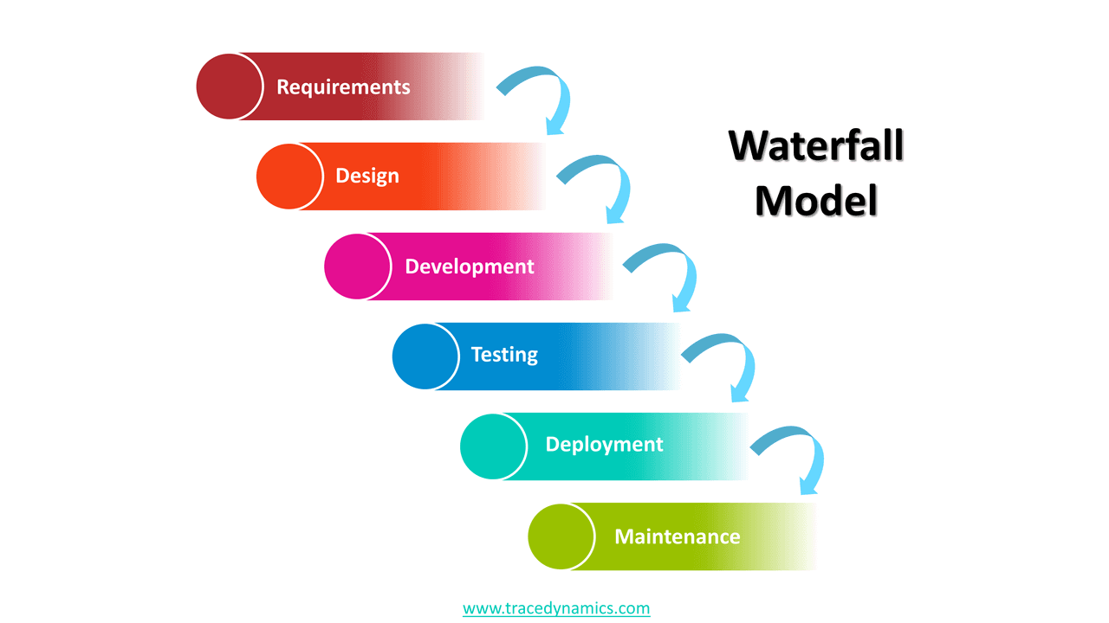
Recap SDLC and Waterfall model
SDLC is a structured way to create and develop software.
Requirement Analysis
Design
Build/
Development
Testing
Install
Deploy
Maintenance
SDD
CODING
Test Plan
Product Deployment
Bug fix
Update
New features
Notes:
Before diving deep into Agile, let’s make a recap about SDLC;
The purpose of SDLC is to follow a discipline that will lead us to develop a successful product.
it allows us to make planning,timing and cost estimation
We can easily control the process of the project.
So It makes the development process more organized. Because this is a teamwork, the team must be well organized.
The main purpose of SDLC is to produce software with the highest quality and lowest cost in the shortest time.
There are 6 phases in SDLC
There are different software development life cycle models
Waterfall is considered to be the oldest configured SDLC model.
This is a traditional model.
What is the main point of waterfall?
In waterfall model phases do not overlap..
after one stage has completed then the next stage starts.
we can say that it is somewhat document driven.
and
Despite its shortcomings, the software development discipline has emerged with this model and is still usable despite its 50-year history.

Slide 5
Table of Contents
Modernizing Project Management
Agile Manifesto
Agile Principles
Overview of Agile Approach
Scrum Overview
Scrum Roles
Notes:
In this slide you can see the todays topics.
We will discuss today, about modern project management,
why we need modern approach in management especially in software development.
we will discuss agile, the agile manifesto, agile principles.
and how those principles effected software development projects.
and lastly we will discuss scrum, one of the implementation of agile model.

Slide 6
Modernizing Project Management
1
Notes:
We observe that the dynamics in the technology world are changing much faster than in the past. With a new technology, users get new habits or needs can change suddenly.
While traditional project management methodologies are successful in stable jobs with their detailed processes, they are slow in industries whose dynamics change rapidly.
Agile project management is an iterative approach to managing software development projects that focuses on iterations and customer feedback with every iteration.
Software teams that using agile project management increase their development speed, expand collaboration, and the ability to better respond to market changes.

Slide 7

Have you heard the Agile approach before?
What is your history about Agile?
Notes:
🍐 This is a Pear Deck Multiple Choice Slide. Your current options are: A: Yes I heard, but I have no history., B: Yes I heard, I have a history about it., C: No, I had no idea.,
🍐 To edit the type of question or choices, go back to the "Ask Students a Question" in the Pear Deck sidebar.
can you please answer this question from peardeck?
have you ever heard about agile? scrum , kanban ?

Slide 8



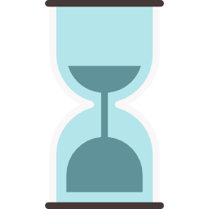

Modernizing Project Management
A project is a planned program of work that requires a definitive amount of time, effort, and planning to complete.
Goals & Objectives
Fixed period of time
Certain budget
Agile approaches are a response to the need to modernize PM.
Notes:
Now lets talk about project management
We can define a project as a planned program of work that requires a definitive amount of time, effort, and planning to complete.
Projects have goals & objectives and usually need to be completed within a fixed period of time and a certain budget.
Agile approaches were born as a response to the need to modernize project management.
In order to understand how Agile approaches have changed the projects, we need some information about
the history of project management
purpose of project management and
the problems in projects.

Slide 9




The Origins of Modern PM
WWII
1940-1950’s
after 1970’s
step-by-step manufacturing
models
manufacturing
process
waterfall
model
On waterfall projects, you move to the next phase only when the prior one is complete — hence, the name waterfall.
Notes:
So before looking the agile mindset, I want to mention the origin of modern project management
Projects have existed since ancient times. people always dealed with large or small projects.
However, project management as we know , it has only existed since the mid-twentieth century.
During World War II, the US military had been advancing in computing and programming.
During this period, formal project management processes were started to be established.
The first processes were based on step-by-step manufacturing models used by the US military
People in the field of information technology had adopted these step-based manufacturing processes,
Because the first computer-related projects were largely based on hardware
you know that old computers only fit in rooms.
Software was a smaller part of computer projects.
In the 1940s and 1950s computers could have thousands of physical vacuum tubes. however, less than 30 lines of programming code were written.
Those first steps, formed the basis of the project management methodology known as waterfall in 1970’s
We have already discussed about waterfall model in SDLC classes
At the beginning it was ok for the software projects.
But something has changed by time.

Slide 10
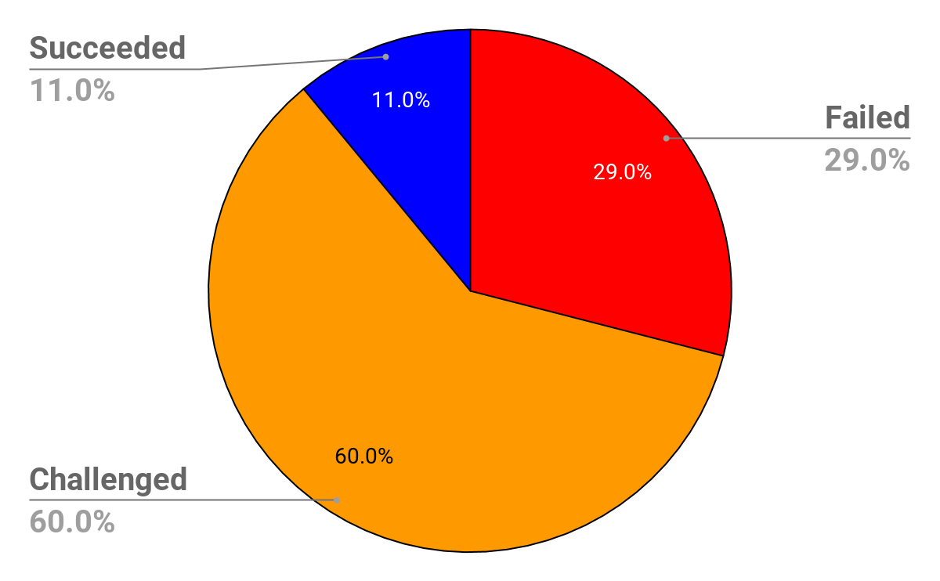
Software Project Success and Failure
Standish Group CHAOS Report
Notes:
This report is called CHAOS report.
Why it was called Chaos?
the results showed that there was a real chaos in software development
But the name is not for this.
CHAOS stands for the Comprehensive Human Appraisal for Originating Software
Guys this slide is the one of the most important one to understand why a modern approach is needed.
a software statistics company called Standish Group did a study on the success and failure rates of projects in the US. These projects are 10,000 projects.
The results of this study showed that 29 percent of traditional projects clearly failed. The projects were either canceled before completion or the projects did not result a product.
60 percent of traditional projects were rejected. The projects have been completed, but there have been serious differences between the expected and the actual product in terms of cost, time, quality.
Only 11 percent of the projects have been fully successful. The projects have been completed and the delivered product that is accepted.
So, In the US alone, billions of dollars spent on application development projects. From this application market, big amount of money were wasted on the projects that were never came to an end.
These losses have been a direct result of traditional project management processes that cannot adapt to the change.
In the last two decades,developers working on projects have noticed increasing problems with traditional project management.
Thus, Agile Project Management emerged.

Slide 11
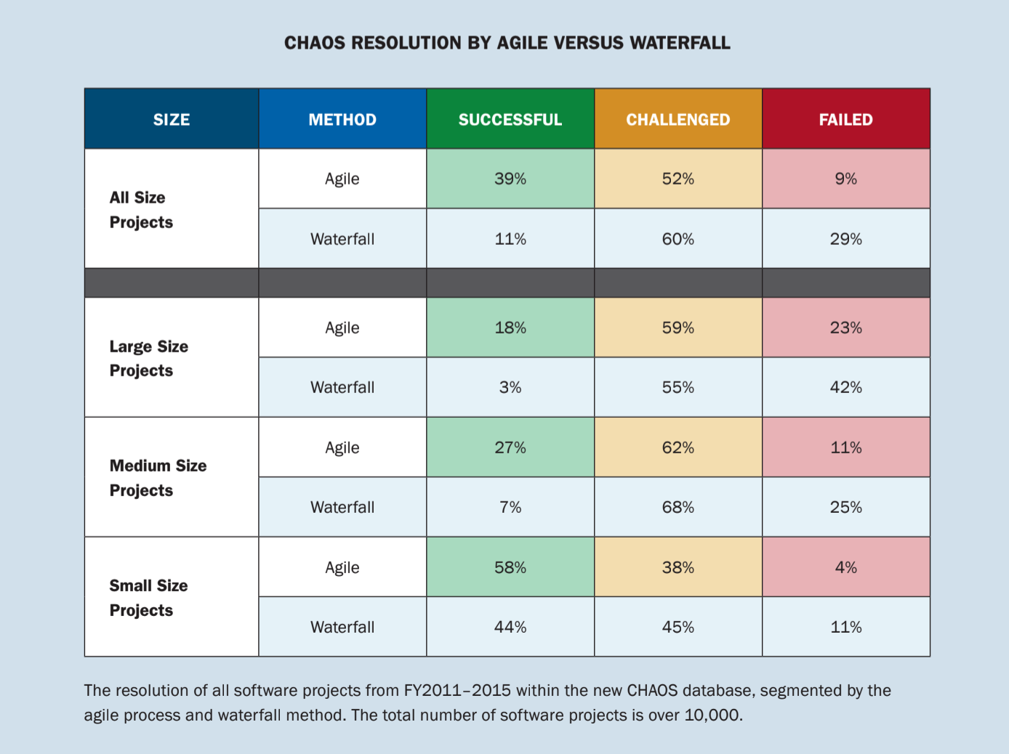
Software Project Success and Failure
Notes:
This table shows agile versus traditional waterfall
lets check the table.
This table shows agile versus traditional waterfall projects
between 2011 and 2015 .
lets check the table.
so something has changed after agile
we can understand it from this table.

Slide 12
Agile Manifesto
2
Notes:
So guys, from where this agile mind set came from? What is the origin?
Lets check about agile manifesto
Now guys, Lets discuss the agile manifesto,
from where this agile mind set came from?
What is the origin?
Who created agile mindset?

Slide 13
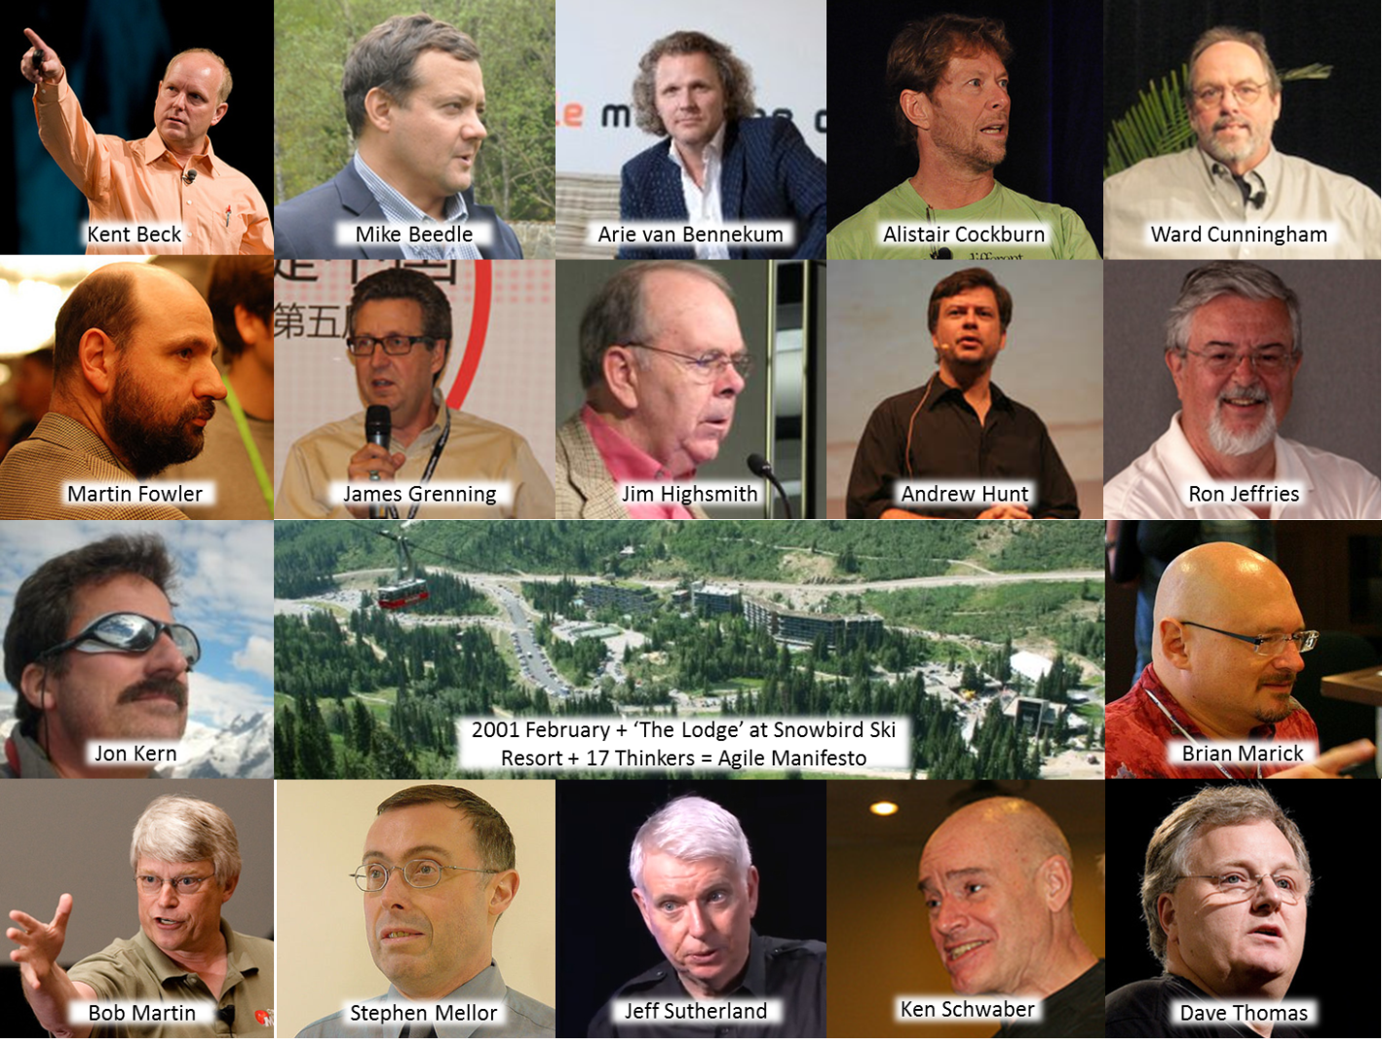
The Agile Manifesto
A group of 17 people thought:
“We’re all doing these different approaches to developing software. We ought to get together and see where there are commonalities in what we’re thinking about.”
The result was a meeting at a ski resort in Snowbird, Utah in 2001.
Notes:
This is the story:
In 2001, a group of software and project experts met at a ski resort in Snowbird, in the state of Utah.
They ski together and have a 2-day brainstorming on problems in software development.
The problem, they agreed, was that companies were so focused on excessively planning and documenting their software development cycles that they lost sight of what is important- the customer satisfaction
They came to a consensus as a result of this meeting and they published the Agile Manifesto, which is a statement that had just 68 words,
yes it is only 68 words
and this short document changed the software development forever.
This declaration has been a guide in software projects over the past 20 years. And eventually Agile mindset turned into a mainstream.
Actually, this people could not imagine the impact of their meeting on the future of project management. The simplicity of this manifesto, and the principles they developed later, transformed the world of information technology.

Slide 14
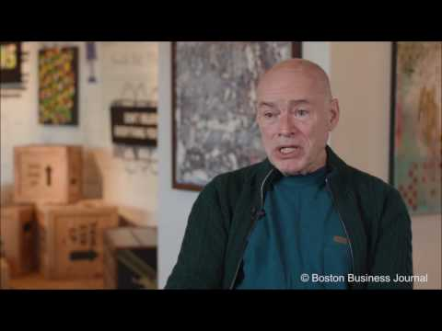
The Agile Manifesto
In this video,
Ken Schwaber, co-creator of Scrum and original member of the group signing the Agile Manifesto in an interview with the Boston Business Journal discusses how it came about.
Notes:
This guy is one the member of the agile manifesto signing group.
Lets listen to him.
he mentions the importance of guidance rather than giving orders to people
this is important part of the agile
I want to take your opinions.
Think you are a manager in a company do you give direct orders to make a job done
or you just give guidance and make your subordinates think about how to done this job?
let me tell an important point in agile
there is no subordinate or superior.
all members of the project is in the same level
Interesting, right?
so how can a project go
without a super powered manager?
We will see

Slide 15
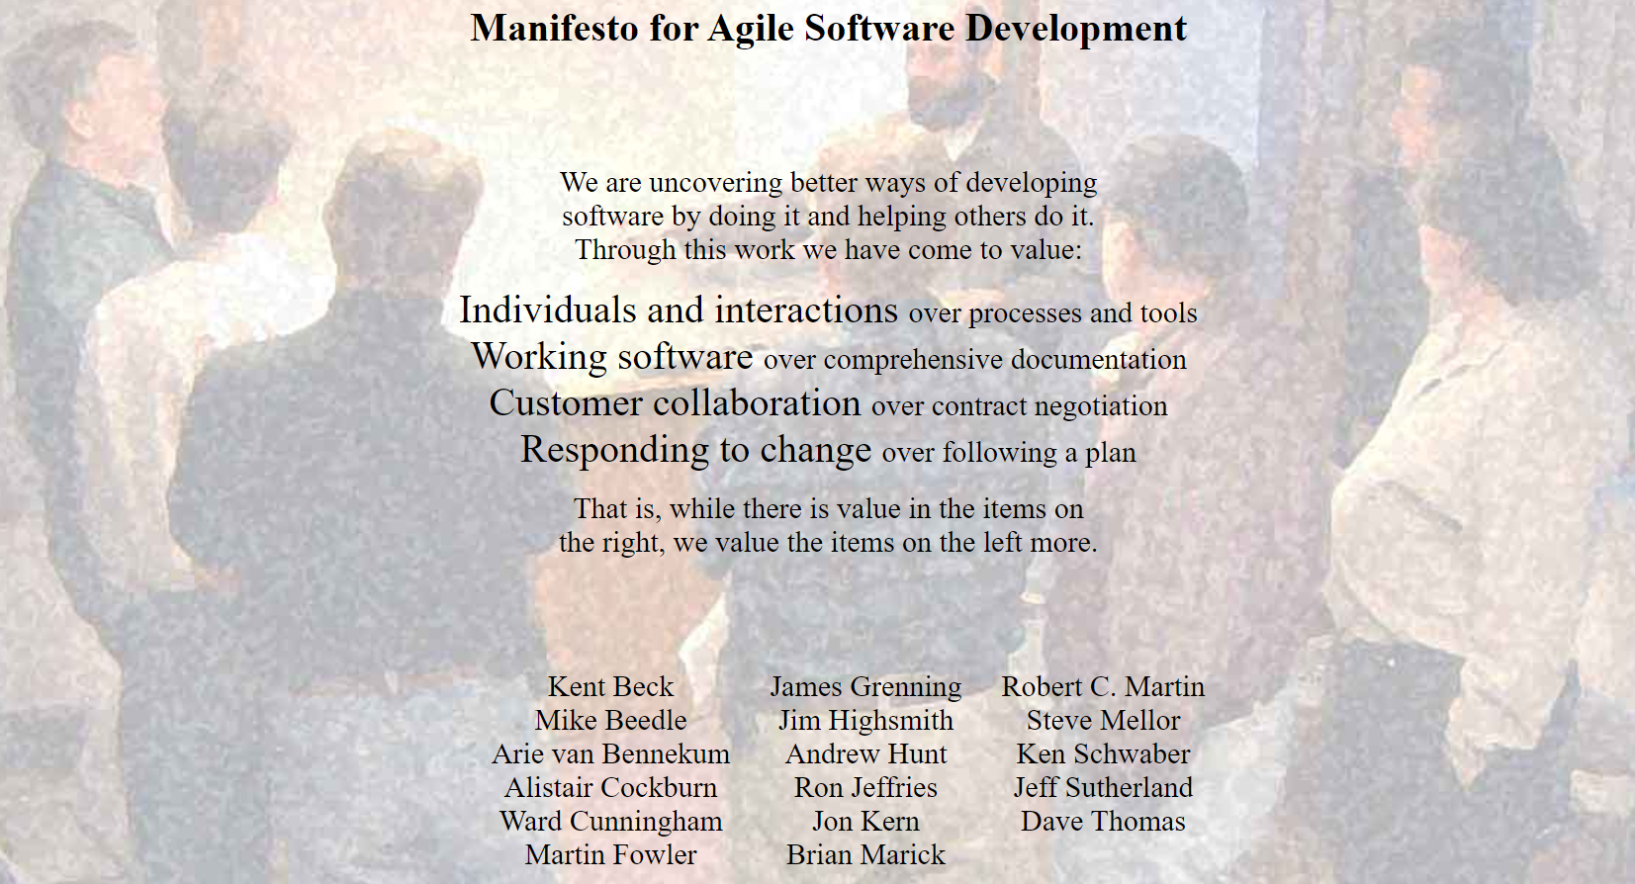
The Agile Manifesto
Notes:
In the Manifesto for Agile Software Development
they said;
Individuals and interactions over processes and tools
Working software over comprehensive documentation
Customer collaboration over contract negotiation
Responding to change over following a plan
In summary, while they accepted the values on the right, they found the items on the left more valuable.
So guys, the items on the right are also very important, but the more important values are those on the left
This is the Manifesto
very short
you see there are values on the left and on the right.
Manifesto is all about the values.
on the right side you can see processes and tools
comprehensive documentation
contract negotiation
following a plan
similar to waterfall, right? we can say traditional values
and on the left side;
Individuals and interactions
Working software
Customer collaboration
Responding to change
Yes, those are the new values.
In summary, while they accepted the values on the right,
they found the items on the left more valuable.
They said ok those on the right side are important but,
We should focus on the values on the left side more than on the right
.

Slide 16
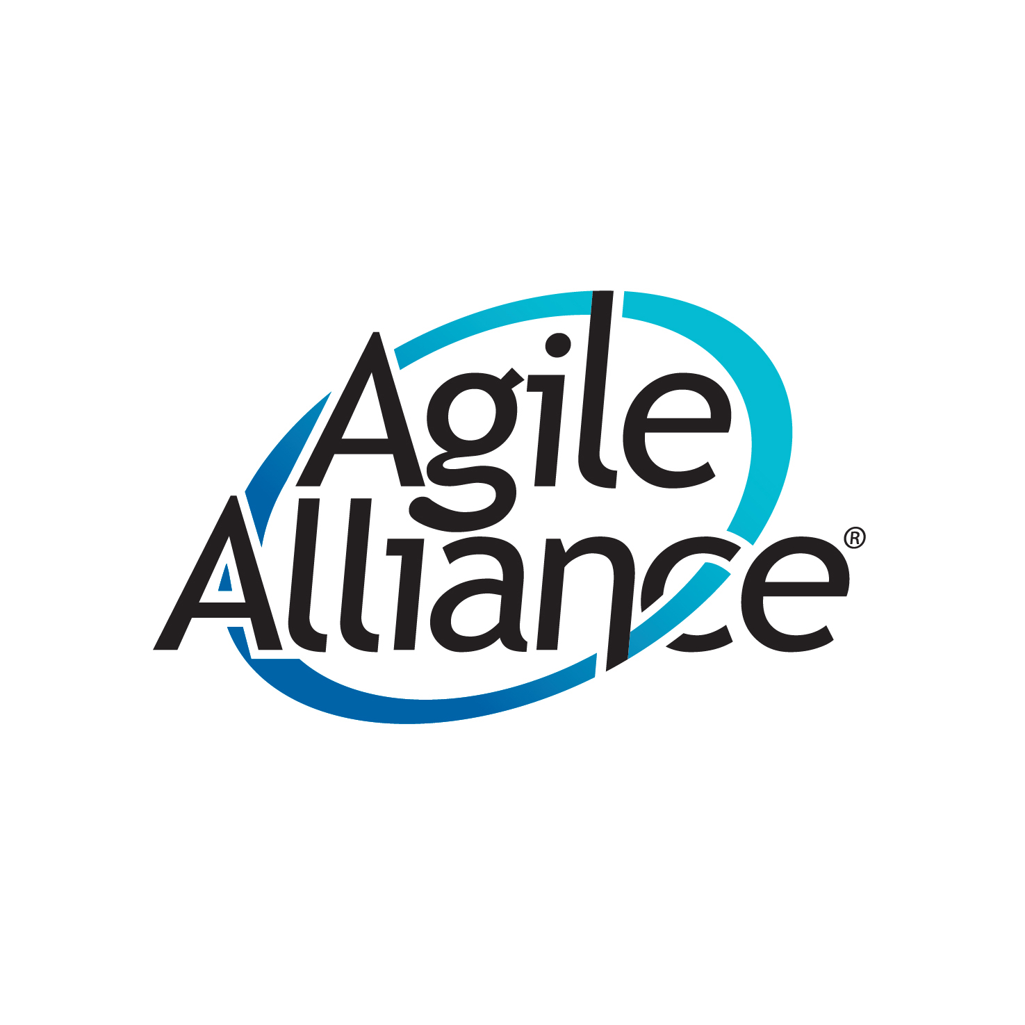

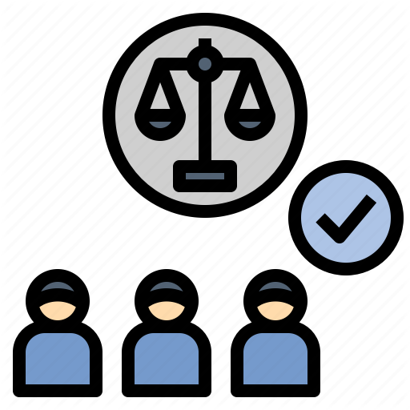
The Group’s Works
Agile Manifesto
Agile Principles
Agile Alliance
Notes:
🍐 This is a Pear Deck Web Slide.
🍐 To edit the type of question, go back to the "Ask Students a Question" in the Pear Deck sidebar.
The group's work was about making the software industry more productive, more humane (kindly) and more sustainable.
This group basically constructed the following 3 main thing:
they created:
Agile Manifesto: Core Development Values
Agile Principles: 12 guiding items that support Agile project teams in the implementation of Agile techniques and these principles support the teams to stay on this path. 12 Principles are based on the Agile Manifesto.
Agile Alliance: Some authors have set up the Agile Alliance, a nonprofit organization that supports software development according to the manifesto's values and principles.

Slide 17
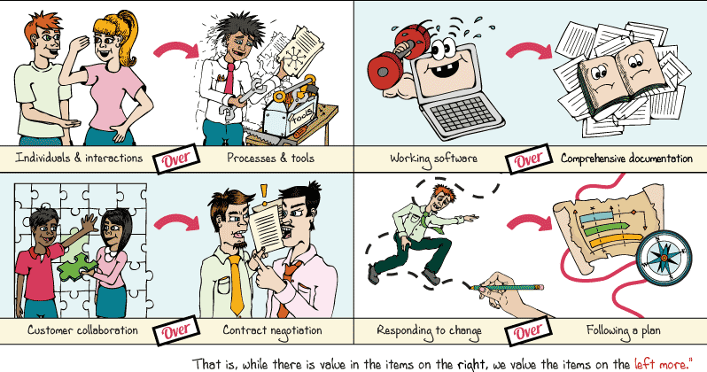
The Four Values of the Manifesto
Notes:
In this slide you can see the 4 values of the manifesto together
Traditional approaches emphasize a tight planing, avoid change, document everything and control everything,
But The manifesto focuses on People, Communication, Product and Flexibility.
The Agile Manifesto is a big change.
Teams focus more on individuals and interactions, collaborate with the customer, respond to change, and produce software that works

Slide 18


Outlining the Four Values
Individuals and Interactions
over
Processes and Tools
Notes:
Now lets check the values one by one
The result can be stronger when you let each person add a value to the project.
When human interactions focus on solving problems, a common purpose can emerge.
In Agile approach, individual face-to-face communication is very important.
A simple conversation about the project can solve many problems in shorter time.

Slide 19

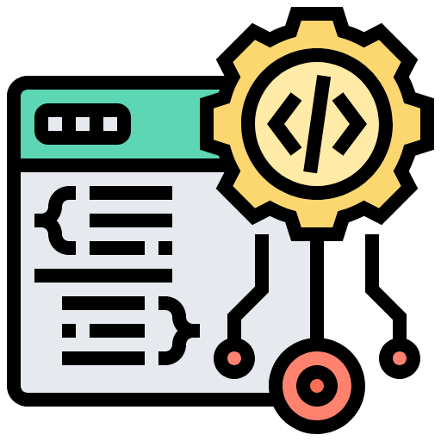
Outlining the Four Values
Working Software
over
Comprehensive Documentation
Notes:
The focus of a development team is to produce a working software. Comprehensive documentation should not be in first place
If the customer does not see a working software, he/she cannot know exactly what he/she wants.
Therefore, when we meet with the customer, it becomes more important to display product increments according to the customer's needs.
when we meet with the customer,
it becomes more important to display product increments according to the customer's needs.
(product increment is what is produced at the end of a specific time period)
(generally it is a 2 week time)-
you show to customer the progress.
And take the opinions.
As a result, the working software would be the main point for the project.
So, should there be no documents in Agile projects?
Of course Some documentation is needed for all projects. For example there is product backlog in Agile. This is a basic document for sprint planning..
But We can say that Agile approaches simplify administrative paperwork.
Of course Some documentation is needed for all projects.
But static documentation such as a software requirements specification (SRS) are
usually a more lightweight documentation of the requirements.
FOR EXAMPLE İN SCRUM THERE ARE USER STORIES.
With user stories you produce product backlog.
This is a basic document for sprint planning..
So , often agile projects capture 'requirements' ;
In the form of use cases, user stories, scenarios, or other user-centric forms.
We can say it is a light weight of SRS.
But some companies first create the SRS and than,
from SRS tries to create user stories.
But this not an agile style

Slide 20
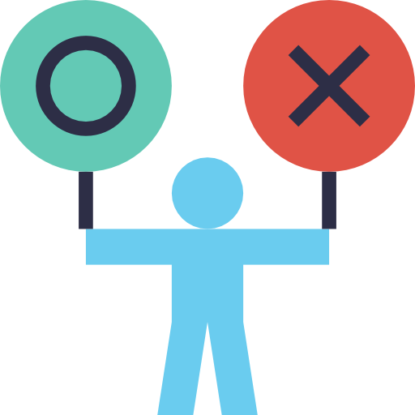
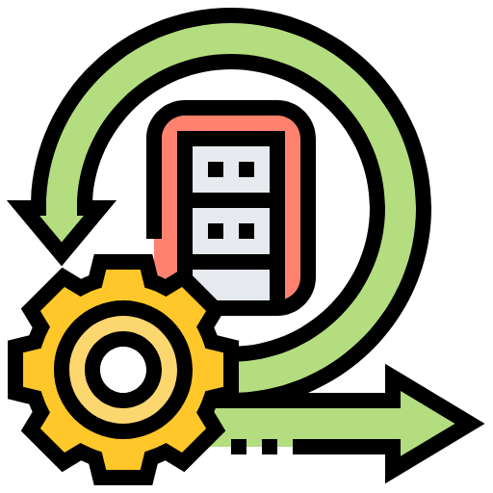
Agile approaches can only be applied in software development, you can not use them for other types of products.
Notes:
🍐 This is a Pear Deck Multiple Choice Slide. Your current options are: A: True, B: False, C: No idea,
🍐 To edit the type of question or choices, go back to the "Ask Students a Question" in the Pear Deck sidebar.
Lets answer this question
Agile approaches can only be applied in software development, you can not use them for other types of products.

Slide 21
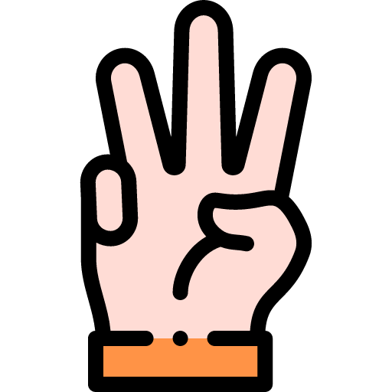

Outlining the Four Values
Customer collaboration
over
Contract Negotiation
Notes:
Lets keep going with the third value
Customer Colloboration rather than contract negotiations
First of all, the customer is not the enemy.
In historical project management approaches, customers generally have three key points:
At the start of a project: That is, when the client and the project manager negotiate the contract details.
When the scope changes during the project: Here the customer and the project manager negotiate the changes made to the contract.
At the end of the project: If the product does not meet the customer's expectations, the project manager and the customer negotiate again for the additional changes.
So this means everything will start from the beginning. Waste of time waste of many things
In fact, using the agile approach, there is a partnership between the customer and the development team.
Customer is also part of the project. For example, In some meetings the customers also come and tell their opinions .

Slide 22
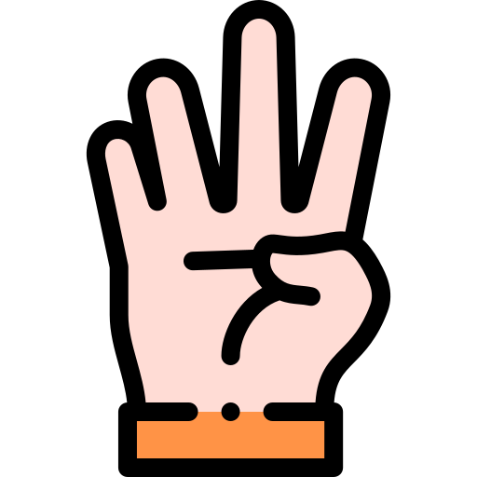
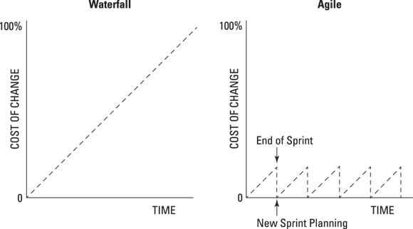
Outlining the Four Values
Responding to change
over
Following a Plan
Notes:
And the last one;
Responding to change rather than sticking to a plan
Change is essential to create products of value. If project teams can quickly respond to customers, users, they can develop useful products.
(soru gelirse: for custom software there is a customer that asks for it and pays for it.
and some other projects are companies own products. after the deployment the users will be the customers.
for example social media applications. they all make changes by the needs of the users)
Unfortunately, traditional project management approaches are far from change. Traditional project teams often go after a plan and miss the opportunity to create creative products.
In contrast, agile projects can systematically adapt to change. The flexibility of agile approaches increases project stability because change in an agile project is predictable and manageable.

Slide 23
Individuals and interactions over processes and tools
Working software over comprehensive documentation
………………………….. over contract negotiation
Responding to change over following a plan
Manifesto for Agile Software Development
Notes:
🍐 This is a Pear Deck Multiple Choice Slide. Your current options are: A: Business communication, B: Customer collaboration, C: Procurement process,
🍐 To edit the type of question or choices, go back to the "Ask Students a Question" in the Pear Deck sidebar.
we have a peardeck question here.
Can yo u please fill in the blanks
(Customer Colloboration)

Slide 24
Agile Principles
3
Notes:
Now lets take a break
after the break we will discuss agile principles
Now we will discuss agile principles

Slide 25


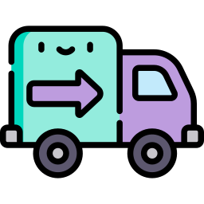

Agile Principles
Our highest priority is to satisfy the customer through early and continuous delivery of valuable software.
Welcome changing requirements, even late in development. Agile processes harness change for the customer's competitive advantage.
1
2
Deliver working software frequently, from a couple of weeks to a couple of months, with a preference to the shorter timescale.
Business people and developers must work
together daily throughout the project.
3
4
Notes:
In the months following the publication of the Agile Manifesto, these people continued to communicate. For Agile teams, they reinforced the Agile values with 12 principles.
The following 12 Principles are based on the Agile Manifesto.
They said We follow these principles:
What are those lets check them and I want to discuss some of them with you, I want to take your opinions.
(yansılardan)
Main point is to satisfy the customer with early and continuous delivery of software.
Welcome changing requirements, even late in development.
Deliver working software frequently, (from a couple of weeks to a couple of months, with a preference to the shorter timescale.)
Business people and developers must work together in the project.
I can give a real life example of all four values.
At my previous job, a customer visited us and wanted a beehive check application
think that he had 200 beehives and he was taking notes about each beehive to a notebook
So we talked about the requirements, needs and everything was ok.
Development team started coding and after the end of the first sprint
we showed the progress we came to the customer
The user logs to the app, creates beehives and than checks everything about the bees.
Suddenly he said I want an admin logs in and than he creates some users because
I can have some beehives in this city and also in another city.
So the person in other places must
create their own beehives and as an admin I can see their beehives too.
So that was something new and something more diffucult to do.
BUt we welcomed the change and talked with development team,
they said İt is ok but we need extra time.
We added this new user story to the project. and added extra time.
At the end,
customer was happy because he got what he wanted.
Business people was happy because we earned money.
and development team was happy because their job was succesful.

Slide 26




Agile Principles
Build projects around motivated individuals. Give them the environment and support they need, and trust them to get the job done.
The most efficient and effective method of conveying information to and within a development team is face-to-face conversation.
5
6
Working software is the primary measure of progress.
Agile processes promote sustainable development.
The sponsors, developers, and users should be able
to maintain a constant pace indefinitely.
7
8
Notes:
5. Build projects with motivated individuals. Give support they need, and trust them to get the job done.
6. The most efficient and effective method of conveying information to and within a development team is face-to-face conversation.
7. Working software is the primary measure of progress.
“Working software is a tested software that delivers value to the end-user,
In other words,
working software is a software which is fully integrated,
tested, and ready to be shipped to customers
8. Agile processes promote sustainable development. They should be able to maintain a constant pace.
I want to discuss that point why do you think a constant pace is important?

Slide 27

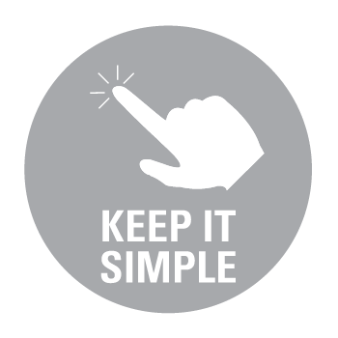


Agile Principles
Continuous attention to technical excellence and good design enhances agility.
Simplicity--the art of maximizing the amount of work not done--is essential.
9
10
The best architectures, requirements, and designs emerge from self-organizing teams.
At regular intervals, the team reflects on how
to become more effective, then tunes and adjusts
its behavior accordingly.
11
12
Notes:
9. Continuous attention to technical excellence and good design enhances agility.
Goals of agility are;
to deliver software of higher quality,
with a higher acceptance to end-users
10. Simplicity--the art of maximizing the amount of work not done--is essential.
In my opinion this is the most important principle. They called the simplicity as an art.
Lets discuss this one. What do you understand from the art of maximazing the amount of work not done?
I think this is about entropy. In thermodynamics second law there is a law says minimum energy and maksimum work.
There is a project and you are making the list of to do’s and there are 100 to do’s. At the end of the projects you will have a 100 dones. If you keep work simple and make the same project with 50 dones you dont have to do other 50 things. So this is maximazing the work not-done?
11. Actually the last two principles completes each other.
The best work comes from self-organizing teams.and the teams At regular intervals, the team have to think about how to become more effective, they need to make self criticism and take feedbacks.

Slide 28
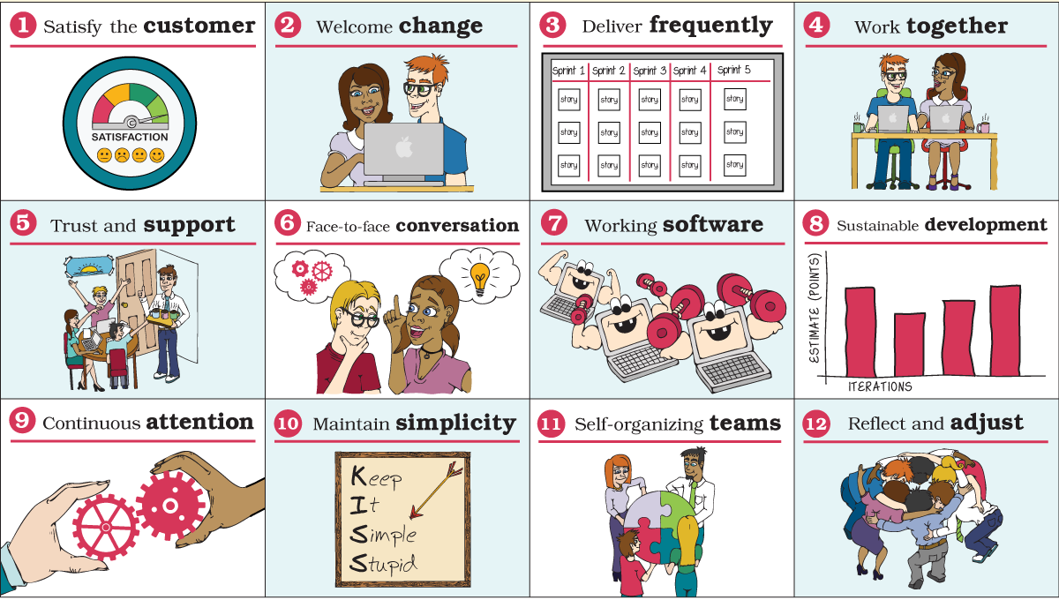
12 Agile Principles
Notes:
Here is the summary of 12 principles in one slide:
(yansıdan oku)

Slide 29

Satisfy the boss
Welcome change
Maintain simplicity
Work together
Which one is NOT an Agile Principle?
Notes:
🍐 This is a Pear Deck Multiple Choice Slide. Your current options are: A: Satisfy the boss, B: Welcome change, C: Maintain simplicity, D: Work together,
🍐 To edit the type of question or choices, go back to the "Ask Students a Question" in the Pear Deck sidebar.
Can you please answer that question?

Slide 30
Overview of Agile Approach
4

Slide 31




Changes as a Result of Agile Values
Agile approaches changed attitudes toward project management processes.
Problem
Solution
Too much process
Notes:
Agile approaches have changed attitudes towards project management processes.
In the past, it is assumed that when trying to improve the Processes, more processes and more formalities would get better results.
Of course, such an approach requires more time, cost and often reduces quality.
The Manifesto and the 12 principles recognized that many processes are a problem, not a solution, and the right amount of the right process differs in each case.

Slide 32

Changes as a Result of Agile Values
Agile approaches changed attitudes toward knowledge workers.
Notes:
Agile approaches have changed attitudes towards information technology employees.
IT groups have begun to remember that development team members are not disposable resources, but individuals whose skills, abilities and innovation make a difference in every project.
Every one is valueble

Slide 33


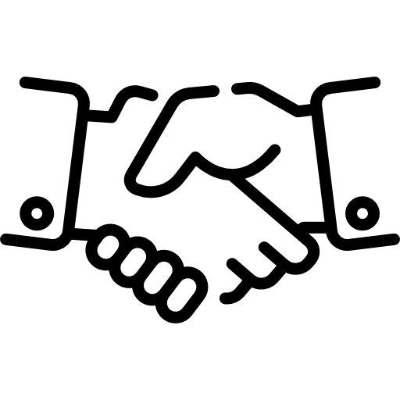
Changes as a Result of Agile Values
Agile approaches changed the relationship between business and IT groups.
Business Team
IT Team
Notes:
Agile approaches have also changed the relationship between business and IT teams.
Agile project management brought these participants together in the same project team, with equal levels of participation and common goals.

Slide 34

Changes as a Result of Agile Values
Agile approaches corrected attitudes toward change.
Notes:
Agile approach corrected attitudes towards change.
Traditional approaches viewed change as a problem to be avoided or minimized.
The Agile Manifesto and its principles helped define change as an opportunity to ensure the implementation of the most knowledgeable ideas.

Slide 35
Agile Methods

Slide 36

Agile Methods
Agile is an umbrella under which many specific methodologies have been developed and are thriving.
AGILE
Feature Driven Development (FDD)
Scrum
Lean
Kanban
Mindset
Test Driven Development (TDD)
Dynamic System Development Methodology (DSDM)
Approach
Umbrella
Extreme Programming (XP)
Notes:
Agile Project Management is not a methodology. It is an approach about how we can manage projects with the administrative and technical tools under the Agile umbrella.
Different tools can be used according to the size of the teams, the current working style and the dynamics of the product to be created.
These tools can be listed as
Dynamic System Development Methodology (DSDM),
Scrum, Kanban, Extreme Programming (XP),
Test Driven Development (TDD),
Feature Driven Development (FDD),
Lean Development.
There is also a sportfy agile model. the audio streaming provider.
you can check after the class
It helps us to adapt to changing market conditions with the continuous delivery process and to produce the right product by including the customer in regular evaluations.
You can find the most suitable tool that will give you the Agile approach by making a pilot project and trying it and constantly improving the process with the perspective of being agile.

Slide 37
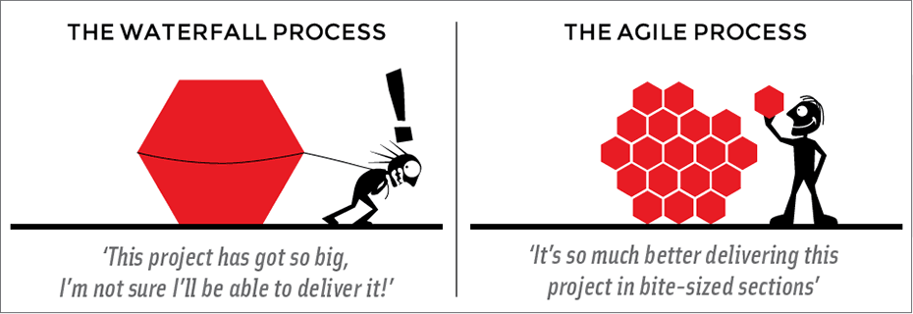
Let’s Wrap it Up
The product can be easily and rapidly developed and tested by dividing it into small pieces.
Small pieces are produced in iteration cycles.
By using iterations, changes can be made without having to wait for the final product.
Notes:
Lets summirise the topic;
The product can be easily and rapidly developed and tested by dividing it into small pieces.
And Agile is an iterative approach to project management and software development that helps teams deliver value to their customers faster and with fewer headaches.
An agile team delivers work in small, but consumable, increments.
Requirements, plans, and results are evaluated continuously so teams have a natural mechanism for respondin g to change quickly.
As we talk about Agile methods
You should know something well.
Keep in mind this:
In all agile methods besides 4 values and 12 principles
there is a simple rule
divide the product into small pieces!
with this way;
The product can be easily and rapidly developed
Changes can be made early
Product can be rapidly tested

Slide 38

In one minute, explain the most important thing about Agile.
Notes:
Now I want you write what do you think about agile and
according to you what is the most important thing in agile
I will give you time to think and write, and than we will discuss it together.

Slide 39


Slide 40
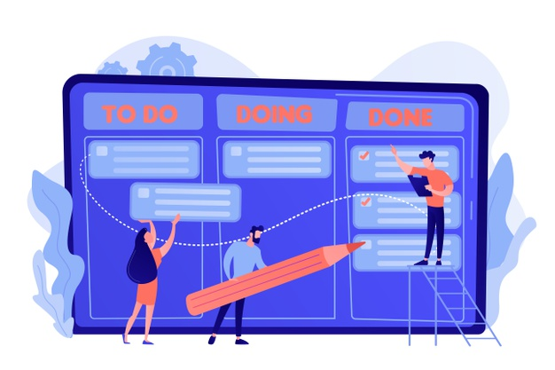
Scrum Overview
5
Notes:
From all of those agile models we will learn Scrum and Kanban
in this course
as they are the most common agile methods
Now lets give a break here. After the break we will have kahoot.
THEN we will start talking about scrum.

Slide 41



What is Scrum?
A framework within which people can address complex adaptive problems, while productively and creatively delivering products of the highest possible value.
Lightweight
Simple to understand
Difficult to master
Notes:
scrum is just a subset of of agile in that sense it enhances operational efficiencies for any sort of team it can be.
It can be a technical team, it can be a business process improvement team, it can be a financial planning and analysis team.
scrum can be applied to all sorts of different teams and disciplines and it's a really great tool for increasing operational efficiency within your department your team your enterprise.
we can start by saying that scrum is a very lightweight.
It's very simple to understand in terms of the methodology and the rules and responsibilities.
However it's difficult for management

Slide 42

What is Scrum?
Scrum emphasizes delivering business value frequently through short iterations known as sprints.
This gives visibility to the work that’s being done and creates opportunities for feedback.
Notes:
Scrum emphasizes delivering business value frequently through short iterations known as sprints.
To develop a successful product, you start by creating a product backlog. This is a list of product features.
By using the Product Backlog, you always work on the most important items first.

Slide 43
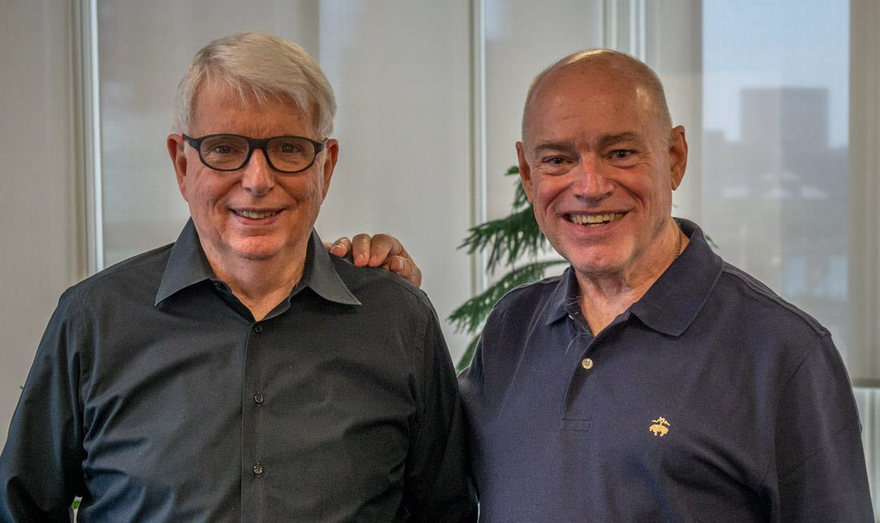
Origin of Scrum
Scrum is one of the leading agile techniques developed in the 1990s by Ken Schwaber and Jeff Sutherland.
More than 50% of all projects use this methodology.
Notes:
This is the interesting point:
In agile manifesto do you see 2 week iterations?
or
the names of the meetings?
The original Agile Manifesto didn't prescribe two-week iterations or an ideal team size. It simply laid out a set of core values that put people first.
Scrum is a implemantation of agile mindset
Scrum is a framework that helps teams work together. It is a framework. What Agile was, it was a mindset, a mindset and a set of values.
Scrum encourages teams to learn through experience, to self-organize while working on a problem.
Makes you think about your gains and losses to improve continuously

Slide 44
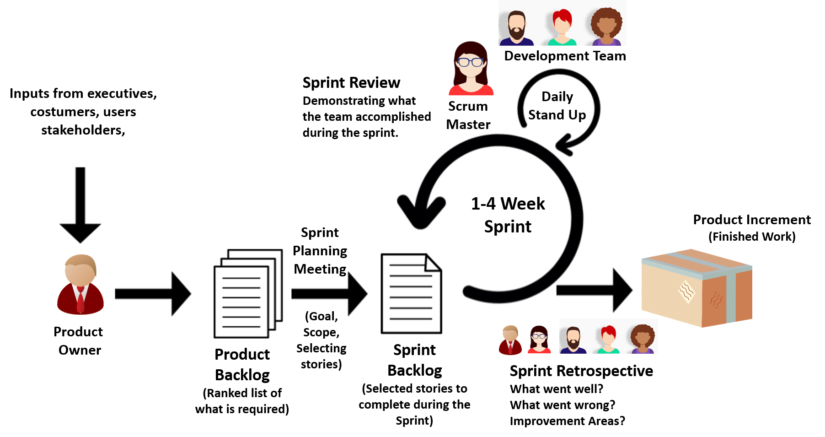
Scrum Framework
Notes:
This slide is the summary of scrum.
Scrum project roles:
Product Owner (Ürün Sahibi)
Development Team (Takım)
ScrumMaster (Scrum Ustası)
There are some documents (scrum calls them artifects)
Product backlog
sprint backlog
product increment
And there are some meetings and of course scrum calls them ceremonies
sprint planning meeting
Daily stand up meeting
Sprint REVİEW meeting
Sprint retrospective meeting
Scrum requires a Scrum Master to foster an environment where:
1. A Product Owner orders the work for a complex problem into a Product Backlog.
2. The Scrum Team turns a selection of the work into an Increment of value during a Sprint.
3. The Scrum Team and its stakeholders inspect the results and adjust for the next Sprint.
4. Repeat
Scrum is simple. Rather than provide people with detailed instructions, the rules of Scrum guide their relationships and interactions.

Slide 45
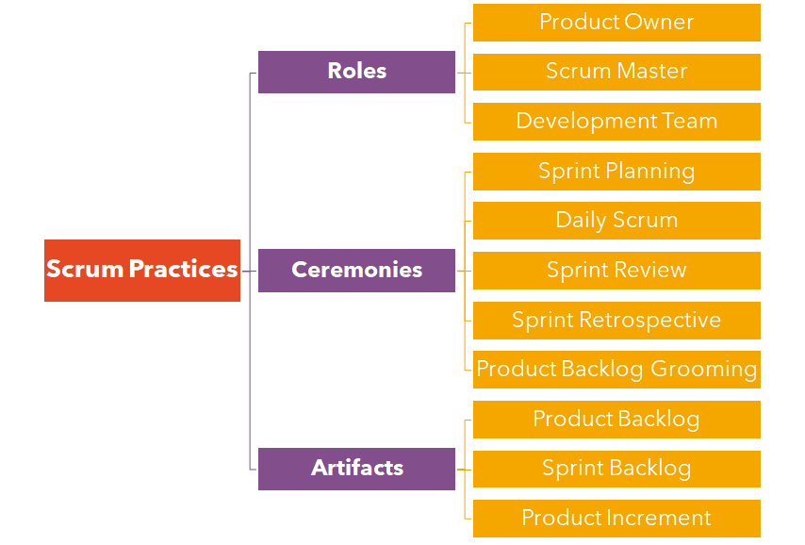



Scrum Practices
Notes:
This is the Scrum terminology. Divided into 3 categories.
(yansıdan anlat)
there are 3 roles , 5 ceremonies and 3 artifacts
Today we will see roles
we will learn ceremonies and artifacts in next lesson.

Slide 46
Scrum Practices
Notes:
This is the Scrum terminology. As I mentioned in previous slide.
There are 3 main elements.
Roles
Ceremonies
Artifacts

Slide 47
Scrum Practices
Notes:
there are 5 ceremonies
those are meetings

Slide 48
Scrum Practices
Notes:
and lastly there are 3 documnets ,
Today We will discuss only roles
and in next week we will talk about ceremonies and artifacts

Slide 49
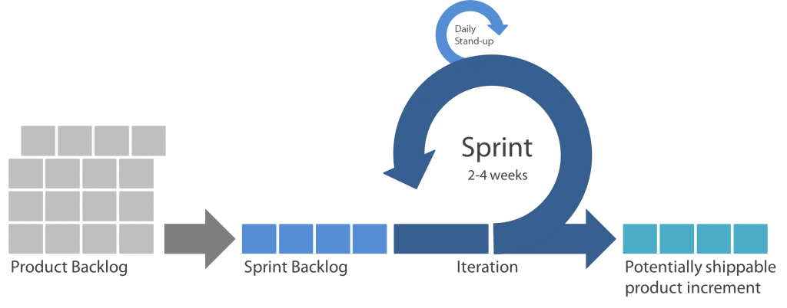
What is Scrum?
True
False
Notes:
🍐 This is a Pear Deck Multiple Choice Slide. Your current options are: A: Mindset, B: Framework, C: Umbrella,
🍐 To edit the type of question or choices, go back to the "Ask Students a Question" in the Pear Deck sidebar.
Can you please write about scrum?

Slide 50
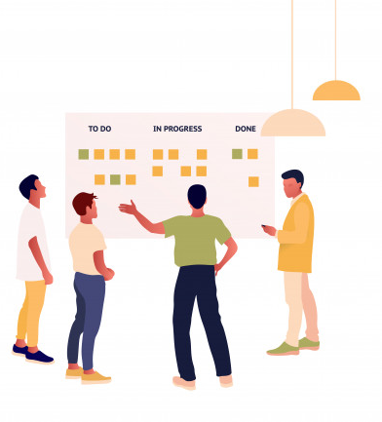
Scrum Roles
6
Notes:
Now lets look at the Scrum roles

Slide 51



Scrum Roles
Responsible for the project’s success by defining the project vision, requirements, and priorities
Accountable to the team to remove impediments that will prevent them from achieving the goals of the Product Owner
Team comprises 3-9 people, with a mix of roles, and self-organizes to determine how to best meet the goals of the Product Owner
Product Owner
Scrum Master
Development Team
Notes:
The Scrum Team consists of a Product Owner, Development Team and a Scrum Master.
Product Owner - The person responsible for the success of the project by defining the project vision and requirements
Scrum Master - The person responsible for removing obstacles that prevent the development team from achieving the goal.
Development Team - The team consists of 5-9 people from different roles, it organizes itself to determine how best to achieve the goals of the Product Owner.

Slide 52
Product Owner
Available
Decisive
Product Owner
Business Savvy
Empowered
Communicative
Notes:
Let's start with the product owner. P.O. is the business representative on the team.
It represents the voice of the stakeholders of the product and the customer. The Product Owner is responsible for maximizing the value of the product resulting from the Development Team's work. How this is done may differ between organizations, Scrum Teams and individuals.
A Product Owner should ideally have the following characteristics:
Available: Always available for planning and disclosure.
Work Experience: Will have a deep understanding of the job or that area.
Communication: It is a good listener, it will have the ability to easily reach stakeholders and adapt the message to the other party.
Empowered: Will have the power to make decisions and can be held responsible for them.
Decisive: Will be able to decide on the direction of the product.

Slide 53

Product Owner
Clearly expressing Product Backlog items
Ordering the items in the Product Backlog to best achieve goals and missions
Optimizing the value of the work the Development Team performs
Ensuring that the Product Backlog is visible, transparent, and clear to all, and shows what the Scrum Team will work on next
Ensuring the Development Team understands items in the Product Backlog to the level needed
Notes:
P.O. always is ordering and working to ensure that the team has the clearly understood details of every request and also that each request is an order of priority.
They are also interacting on a daily basis with stakeholders. It's not enough for the people to interact with a team.
They must also be in tune with all the changes that are occurring within the business context.
As a result the keeper of the product vision he or she defines and manages the backlog of work to be done and prioritizes these work items.
The PO is painfully aware that the work must be continuously sorted to the highest value.
There are also pushing the team to complete as much work as possible in each short delivery period.

Slide 54
Scrum Master
The Scrum Master is responsible for promoting and supporting Scrum
Responsible
Committed
Scrum Master
Humble
Influential
Collaborative
Knowledgeable
Notes:
Now if you're wondering how on earth the team can keep up with these demands you're not alone.
The founders of scrum recognises the need for counter-balance to the “product owner” role.
So they created a role of master.
the scrum master protects the team and protects the process.
Scrum Masters fulfill these responsibilities by helping everyone understand Scrum theory, practices, rules, and values.
They balance the demands of the people against the needs of the team.
This role is the first safety valve to ensure that teams are performing to a sustainable level. We don't want them to get burned out before they reach the finish line.
So Scrum Masters should ideally have:
Responsible: Activating the team and maximizing team output
Humble: Allows the team to achieve victory without letting the ego
Collaborative: Creates a culture of collaboration in the team
Commitment: show 100% commitment to the team, even if they are not full-time Scrum Masters
Influential, said: Being able to make an impact without authority
Knowledgeable: Scrum expert and technical environmental knowledge

Slide 55
Scrum Master
Scrum Master Service to the Product Owner
Ensuring that goals, scope, and product domain are understood
Finding techniques for effective Product Backlog management
Helping the Scrum Team understand the need for clear and concise Product Backlog items
Understanding product planning in an empirical environment
Ensuring the Product Owner knows how to arrange the Product Backlog to maximize value
Understanding and practicing agility
Facilitating Scrum events as requested or needed
Notes:
The Scrum Master serves to the Product Owner in different ways, including:
Guaranteeing that everyone on the Scrum Team understands the aims, scope, and product domain as much as possible.
Seeking strategies for efficient handling of Product Backlog.
Helping the Scrum team appreciate the need for a product backlog list to be transparent and descriptive.
Knowing product planning within an analytical framework.
Ensuring the Company Owner understands how the product backlog can be managed to optimize profit.
Comprehension and practice of agility.
Offering scrum events as needed or necessary

Slide 56
Scrum Master
Scrum Master Service to the Development Team
Coaching the Development Team in self-organization and cross-functionality
Helping the Development Team to create high-value products
Removing impediments to the Development Team’s progress
Facilitating Scrum events as requested or needed
Coaching the Development Team in organizational environments in which Scrum is not yet fully adopted and understood
Notes:
The Scrum Master serves to the Development Team in different ways, including:
Helping the marketing team build value-added goods.
Removing barriers to success from the development Team.
Providing Scrum events as requested or required.
Coaching the Development team in corporate environments where Scrum is still not completely implemented and recognized.

Slide 57
Which one looks at the project from the customer's perspective?
True
False
Notes:
🍐 This is a Pear Deck Multiple Choice Slide. Your current options are: A: Product Owner, B: Scrum Master,
🍐 To edit the type of question or choices, go back to the "Ask Students a Question" in the Pear Deck sidebar.
Lets answer this question

Slide 58
What is the role of the Scrum Master?
True
False
Notes:
🍐 This is a Pear Deck Multiple Choice Slide. Your current options are: A: Dictates the development team how to do things, B: Orders the items in the Product Backlog to best achieve goals and missions, C: Serves the development team and shields them from any distractions,
🍐 To edit the type of question or choices, go back to the "Ask Students a Question" in the Pear Deck sidebar.
who is scrum master what is his or her role?
What is the role of the Scrum Master?
maybe you can say also B is true but the point is scrum master does not order, maybe we can say just guide and follow the process.
so the answer is C.

Slide 59

Development Team
The Development Team consists of professionals who do the work of delivering a potentially releasable Increment of “Done” product at the end of each Sprint.
Development Team
Product Increment
Each Sprint
Notes:
The Development Team consists of professionals who are responsible for delivering a potentially releasable part of the product that meets the definition of "Done" at the end of each Sprint (iteration).
A piece of product that meets the definition of "Done" in the Sprint Review is required. Only members of the Development Team develop the Increment.
Development Teams are teams established and empowered by the organization to organize and manage their own work. The resulting synergy maximizes the Development Team's overall efficiency and effectiveness.

Slide 60
Development Team
They are self-organizing.
Development Teams are cross-functional.
Scrum recognizes no titles for Development Team members.
Scrum recognizes no sub-teams in the Development Team.
Accountability belongs to the Development Team as a whole
Notes:
Development Team members are ‘programmers’.
What it means is that all members of the Development Team are working together to develop products or services in complex environments.
Development Teams have the following characteristics:
They are self-organizing. No one (not even the Scrum Master) tells the Development Team how to turn Product Backlog into Increments of potentially releasable functionality;
Development Teams are cross-functional, with all the skills as a team necessary to create a product Increment;
Scrum recognizes no titles for Development Team members, regardless of the work being performed by the person;
Scrum recognizes no sub-teams in the Development Team, regardless of domains that need to be addressed like testing, architecture, operations, or business analysis; and,
Individual Development Team members may have specialized skills and areas of focus, but accountability belongs to the Development Team as a whole.

Slide 61
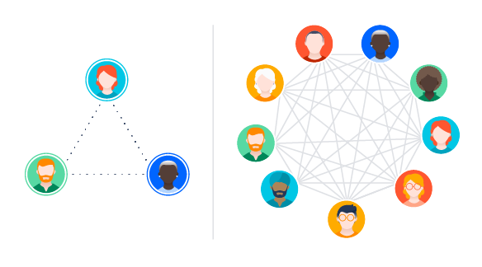
Team Size vs. Coordination
Notes:
There isn’t one, universally correct answer for optimal team size, but there are a number of factors worth considering when figuring out what will work best for your team.
In a team, each individual will connect with another individual and form a unique relationship. The bigger the team, the more the relationships.
Why does this matter and how can it help you? Each new person adds some individual productivity to the Team, but they also increase the communications overhead in the form of an exponentially growing number of relationships. To increase a team from 5 to 7 people, you have to more than double the number of relationships.
A general rule of thumb suggests that people typically have from 3 to 5 hours of productive time at work each day. As a team gets larger, we either lose productivity or, more often, we start to withdraw socially rather than sacrifice productive time for interacting with our peers, because the communication costs for each team member is becoming too high to afford.

Slide 62





Development Team Size
Small Team
Large Team
3-9 Members
Coordination
Product Increment
Notes:
So what?
According to the Scrum Guide, the development team should be between three and nine people and should have all the skills necessary to deliver product increments.
The number of developers is usually dictated by the needs of the product and usually is between two and five developers in a scrum team.

Slide 63
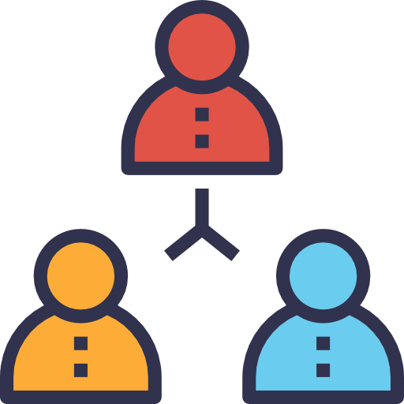
What do we mean by a cross-functional Development Team?
True
False
Notes:
🍐 This is a Pear Deck Multiple Choice Slide. Your current options are: A: The Development Team should collaborate with the other Development Teams, B: The Development Team should have all the skills necessary to deliver the Done Increment, C: The Development Team consist of Developers and Testers,
🍐 To edit the type of question or choices, go back to the "Ask Students a Question" in the Pear Deck sidebar.
There is a peardeck question again:
what is cross functional team?

Slide 64
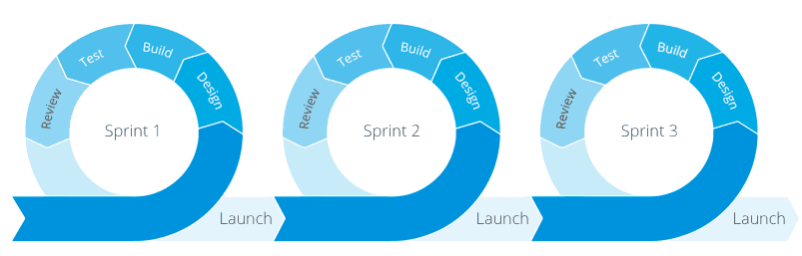
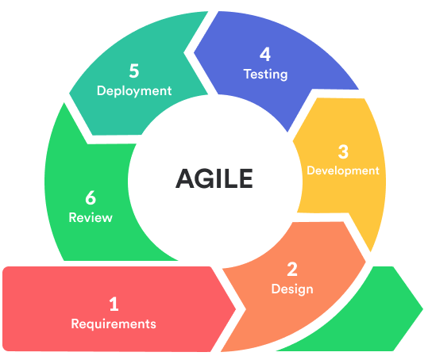
Agile Model
Each iteration lasts from 1 - 3 weeks
Notes:
Agile SDLC model is a combination of iterative and incremental
process models with focus on process adaptability and customer
satisfaction by rapid delivery of working software product.
Agile Methods break the product into small incremental builds. These builds are provided in iterations. Each iteration typically lasts from about one to three weeks. Every iteration involves cross functional teams working simultaneously on various areas like planning, requirements analysis, design, coding, unit testing, and acceptance testing. At the end of the iteration a working product is displayed to the customer and important stakeholders.

Slide 65
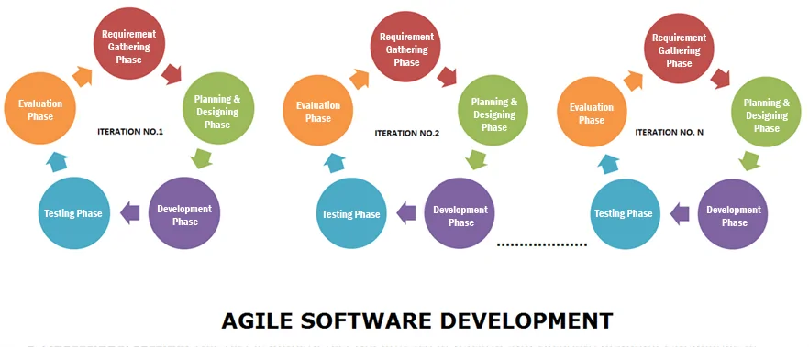
Agile Model
Notes:
What is Agile?
Agile model believes that every project needs to be handled differently and the existing methods need to be tailored to best suit the project requirements. In agile the tasks are divided to time boxes (small time frames) to deliver specific features for a release.
Iterative approach is taken and working software build is delivered after each iteration. Each build is incremental in terms of features; the final build holds all the features required by the customer.
Agile thought process had started early in the software development and started becoming popular with time due to its flexibility and adaptability.

Slide 66
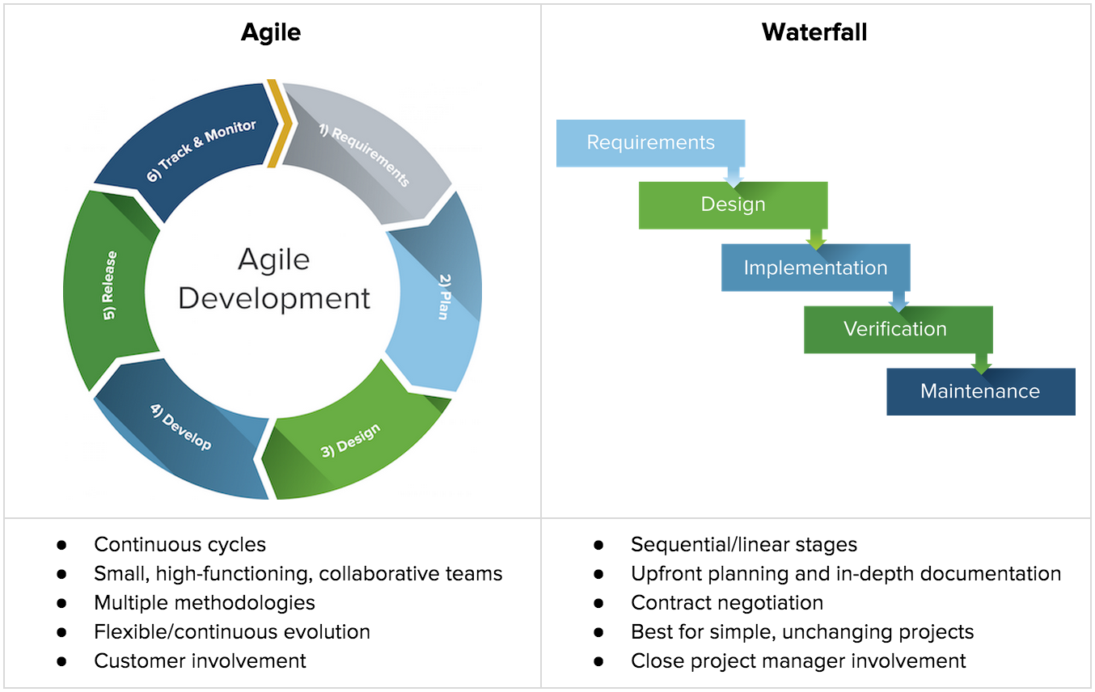
Agile Vs Traditional SDLC Models
Notes:
Agile is based on the adaptive software development methods where as the traditional SDLC models like waterfall model is based on predictive approach.
Predictive teams in the traditional SDLC models usually work with detailed planning and have a complete forecast of the exact tasks and features to be delivered in the next few months or during the product life cycle. Predictive methods entirely depend on the requirement analysis and planning done in the beginning of cycle. Any changes to be incorporated go through a strict change control management and prioritization.
On the other hand; Agile uses adaptive approach where there is no detailed planning and there is clarity on future tasks only in respect of what features need to be developed. There is feature driven development and the team adapts to the changing product requirements dynamically. The product is tested very frequently, through the release iterations, minimizing the risk of any major failures in future.

Slide 67

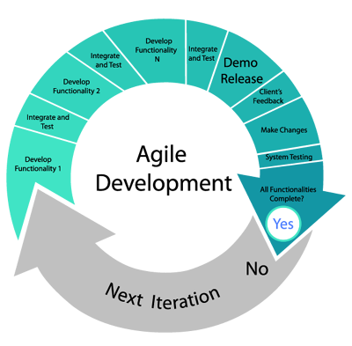
Agile Vs Traditional SDLC Models
Notes:
Customer interaction is the backbone of Agile methodology, and open communication with minimum documentation are the typical features of Agile development environment.
The agile teams work in close collaboration with each other and preferably are most often located in the same geographical location.
Agile methods are being widely accepted in the software world recently, however, this method may not always be suitable for all products. Of course there are some pros and cons of the agile model.
There are some project management tools as methots in Agile Model like Scrum, Kanban etc.
But I will not go in deep, since you are gonna see in detail soon.

Slide 68

THANKS!
Any questions?

